Slide 1
The Eye

Slide 2
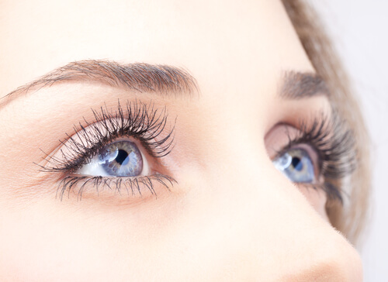
By the end of this lesson you should be able to answer the following questions:
1. | State the main structures of the eye.
2. | Describe the functions of the rods and cones in the eye.
3. | Explain how your eye processes the information it receives into a visual image.

Slide 3
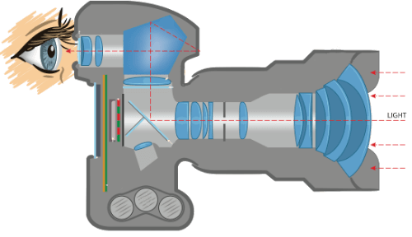
Your eyes are what allow you to see.
Your eyes work in a similar way to a camera! They take pictures of the world around you and send the pictures to your brain. The brain then processes the information to work out what you are seeing!

Slide 4
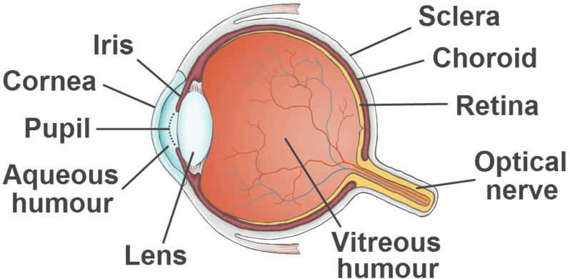
The eye is composed of many parts, which can be seen in the diagram below.
Let's have a brief look at each of these different parts of the eye and see how they function.

Slide 5
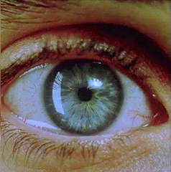
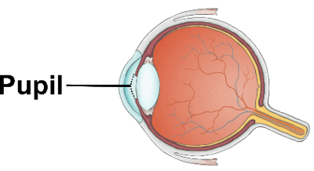
The Pupil
Have a look at your eyes in the mirror, or look at your friend's eyes. The black hole in the middle of the eye is the pupil. The main function of the pupil is to allow light into the eye.
You may have noticed that it gets very small in bright light and bigger in dull light. If not, check it out in the image below!

Slide 6
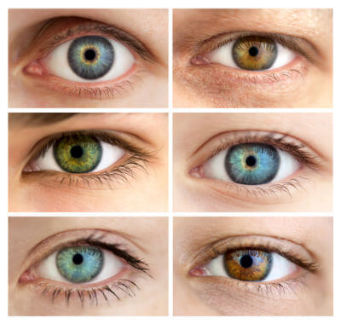
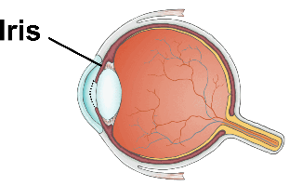
The Iris
The coloured part of your eye is called the iris. What coloured iris do you have?
The iris is a ring of muscle and its main function is to control the amount of light that enters the eye. It does this by changing the size and the diameter of the pupil.
Controlling the amount of light entering the eye is important to protect the eye from being exposed to too much light.

Slide 7
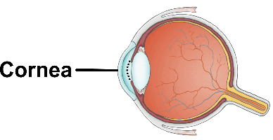
The Cornea
The cornea is the see-through skin that covers the front of your eye.
It is clear like glass and it has no blood vessels in it. It plays an important role in focusing your vision.

Slide 8
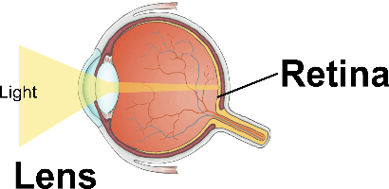
The Lens
The lens is a clear jelly like substance, and focuses light onto the retina (back of the eye). Muscles that are attached to the lens can make the lens thicker or thinner to ensure that the light is focused onto the retina.
Like the cornea, the lens does not contain any blood vessels.

Slide 9
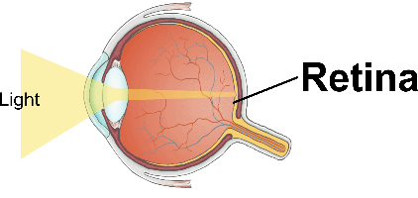
The Retina
The retina is the tissue lining the back of the eye and is where all the photoreceptors (sensory receptors of the eye) are located. The photoreceptors allow the retina to detect light.
The lens focuses the light onto the retina, and the purpose of the retina is to convert the light into an electrical message for the brain.

Slide 10
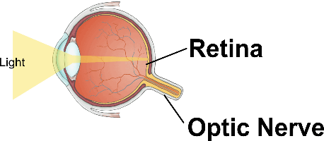
The Optic Nerve
The optic nerve sends the electrical messages that it receives from the retina to your brain, which interprets the message as images that you can see!

Slide 11
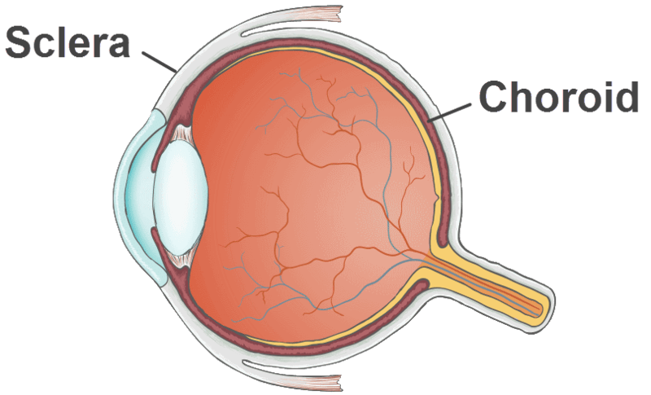
The Sclera and Choroid
In addition to the parts already described, the eye is surrounded by two layers: the sclera and the choroid.
The sclera is a thick, tough layer that surrounds most of the eye. It helps the eye maintain its shape and serves as an attachment point for muscles that move the eye.
Just inside the sclera is another layer, called the choroid. The choroid contains blood vessels, which bring nutrients to the eye.

Slide 12
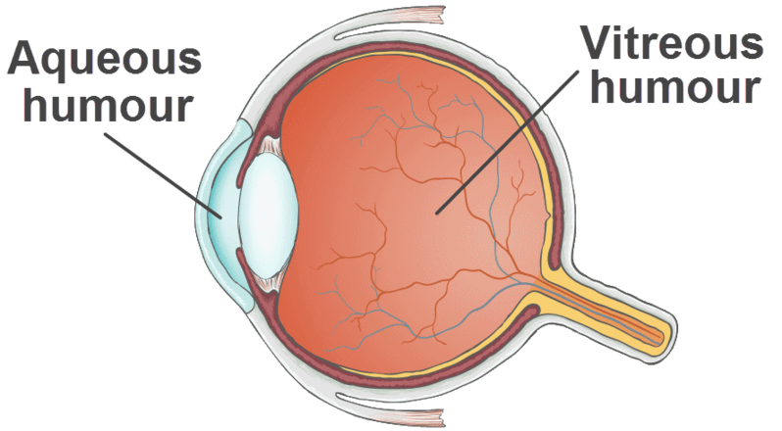
The Vitreous Humour and the Aqueous Humour
The eye is also full of two clear fluids: the vitreous humour and the aqueous humour.
The vitreous humour is a jelly-like substance in the middle of the eye that helps it keep its shape.
The aqueous humour is a watery liquid that helps distribute nutrients to the cornea and lens. This is important, since the cornea and lens have no blood vessels, and blood vessels are how most tissues receive nutrients.

Slide 13
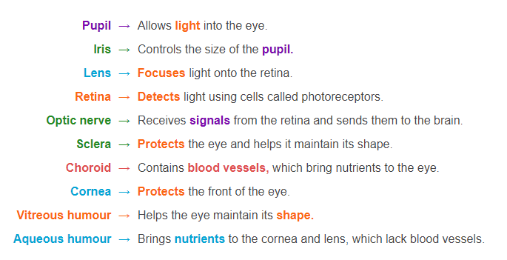
Summary of the parts of the Eye
As you can see, each of the parts in the eye serve a specific function. You can review these functions below.

Slide 14
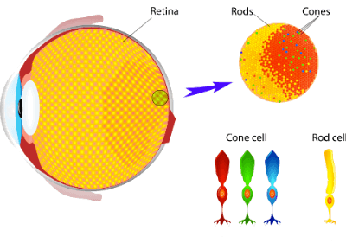
The sensory receptors in our eyes are called photoreceptors.
Photoreceptors are the cells that detect and respond to light.
These are located on the retina, and can be split into two types: rods and cones.

Slide 15
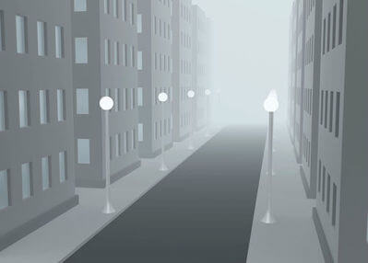
Rods
Rods are good at detecting differences in light, movement and shapes. These cells are not good for colour vision.
You use these cells when you are in a dimly lit room.
The majority of photoreceptors in the eye are rods.

Slide 16
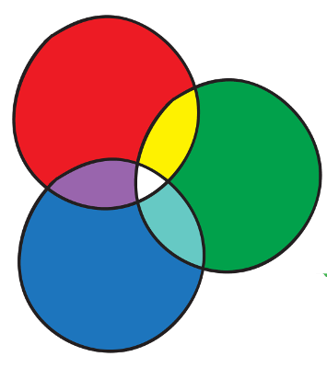
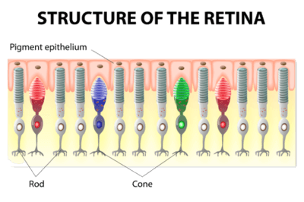
Cones
Cones are good at detecting colour. However, cones require lots of light to work, so do not work well in dim conditions. This is why colours are less visible in a dimly lit room!
There are three types of cones, each of which detects a different colour of light: red, blue or green.
Signals from the cones are sent to the brain which then translates these messages into what we see as colour!

Slide 17

Eye Diseases
Sometimes we can have problems with our eyesight!
If you wear glasses, or know people around you who wear glasses, you'll know that glasses are commonly used to correct eyesight problems to help the person to be able to see properly.
Some common vision problems include nearsightedness, farsightedness, and presbyopia.

Slide 18
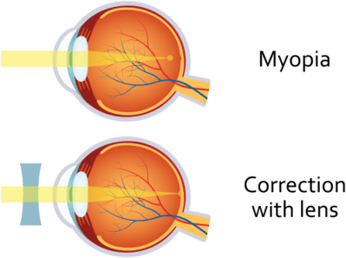
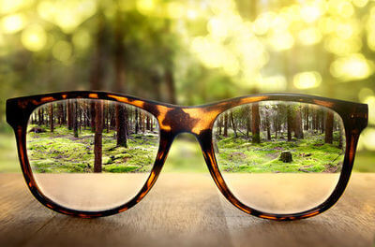
Myopia
Nearsightedness, also known as myopia is an eye condition that results in the lens focusing the light in front of the retina, instead of on it. This problem is usually a result of the eyeball being too long.
This causes things that are far away to appear blurry to a person, however, they can see things that are up close. To fix this problem, glasses with a lens that can focus light on the retina is used.

Slide 19
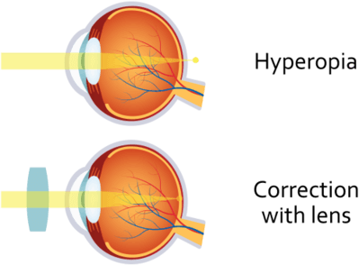

Hyperopia
Farsightedness, also known as hyperopia is an eye condition that results in the lens is focusing the light behind the retina, instead of on it. This problem is usually a result of the eyeball being too short.
This means that a person can see things that are far away, but things that are up close appear blurry.

Slide 20
Presbyopia
Presbyopia, is an age-related eye condition that is found in older people. This condition causes the lens in the eye to harden, so that light is focused behind the retina, rather than in front.
This means that objects that are up close appear blurry.

Slide 21

Eye Safety is Important!
Your eyes are at work from the moment you wake up to the moment you close them to go to sleep. They take in a whole lot of information about the world around you.
Your eyes are pretty amazing, therefore it is important to protect them to the best of your ability.

Slide 22
Here are some things that you can do to protect your eyes and keep them healthy!
1. | Wear sunglasses when outside in the sunlight.
2. | If you are looking at a computer screen a lot, let your eyes take a break every 20 minutes or so, by looking away into the distance
3. | Use proper eye protection when needed, like working in the lab, or playing particular sports.
4. | Don't forget to blink often!

